Slide 1
Week 2 and 3
‹#›

Slide 2
Pseudocode & Algorithm
Example 1: Write an algorithm to determine a student’s final grade and indicate whether it is passing or failing. The final grade is calculated as the average of four marks.
‹#›

Slide 3
Pseudocode & Algorithm
Detailed Algorithm
Step 1: Input M1,M2,M3,M4
Step 2: GRADE ← (M1+M2+M3+M4)/4
Step 3: if (GRADE < 60) then
Print “FAIL”
else
Print “PASS”
endif
‹#›

Slide 4
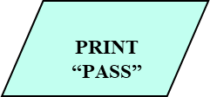
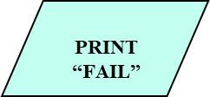
Example 1
START
Step 1: Input M1,M2,M3,M4
Step 2: GRADE ← (M1+M2+M3+M4)/4
Step 3: if (GRADE <50) then
Print “FAIL”
else
Print “PASS”
endif
Input
M1,M2,M3,M4
GRADE←(M1+M2+M3+M4)/4
IS
GRADE<50
N
Y
STOP
‹#›

Slide 5
Example 2
Write an algorithm and draw a flowchart to convert the length in feet to centimeter.
‹#›

Slide 6
Example 2
Flowchart
Algorithm
Step 1: Input Lft
Step 2: Lcm 🡸Lft x 30
Step 3: Print Lcm
START
Input
Lft
Lcm 🡸 Lft x 30
Print
Lcm
STOP
‹#›

Slide 7
Example 3
Write an algorithm and draw a flowchart that will read the two sides of a rectangle and calculate its area.
‹#›

Slide 8
Example 3
Algorithm
Step 1: Input W,L
Step 2: A 🡸L x W
Step 3: Print A
START
Input
W, L
A 🡸L x W
Print
A
STOP
‹#›

Slide 9
Example 6
We want to create a flowchart that prints out the biggest of three inputted numbers
‹#›

Slide 10
Example 6
Step 1: Input A, B, C
Step 2: if (A>B) then
if (A>C) then
MAX 🡸A [A>B, A>C]
else
MAX 🡸C [C>A>B]
endif
else
if (B>C) then
MAX 🡸B [B>A, B>C]
else
MAX 🡸C [C>B>A]
endif
endif
Step 3: Print “The largest number is”, MAX
‹#›

Slide 11
Example 6
Flowchart: Draw the flowchart of the above Algorithm.
On the following slide, a number of potential boxes you could use to correctly implement the algorithm.
‹#›

Slide 12
START
Read A, B, C
A>B ?
Yes
Yes
No
Yes
No
No
END
‹#›

Slide 13
Pick the appropriate three of the following boxes that describe the algorithm as described.
B<C?
B>C?
Print A
A<C?
A>C?
Print B
A<B?
A>B?
Print C
‹#›

Slide 14
START
Read A, B, C
A>C
A>B ?
B>C ?
Yes
Yes
No
Yes
No
No
Print A
Print B
Print C
END
‹#›

Slide 15
Example 7
We want to create a flowchart that prints out the word “Honour” if the number input is 70, if the number is less than 40 print out the word “Fail”, otherwise print out the word “Pass”.
On the following slide, a number of potential boxes you could use to correctly implement the algorithm.
‹#›

Slide 16
START
Read A
Yes
No
No
Yes
END
‹#›

Slide 17
Pick the appropriate three of the following boxes that describe the algorithm as described
A < 70?
A > 70?
Print “Honour”
A < 40?
A > 40?
Print “Fail”
A > Pass?
A > Honour?
Print “Pass”
‹#›

Slide 18
START
Read A
A<40?
Yes
No
A<70
No
Yes
Fail
Pass
Honour
END
‹#›

Slide 19
Example 8
We want to create a flowchart that prints out the average value of five numbers input in.
On the following slide, a number of potential boxes you could use to correctly implement the algorithm.
‹#›

Slide 20
START
Total = 0
A = 1
No
Yes
END
‹#›

Slide 21
Pick the appropriate three of the following boxes that describe the algorithm as described.
Is A==6?
Is A==5?
Is A==0?
Print Total
Print Total / 5
Print Total++
Total = X
Total = Total
Total = Total + X
Read A
Read Total
Read X
‹#›

Slide 22
START
Total = 0
A = 1
A = A + 1
Total = Total +X
A == 6
No
Read X
Yes
Print Total
END
‹#›

Slide 23
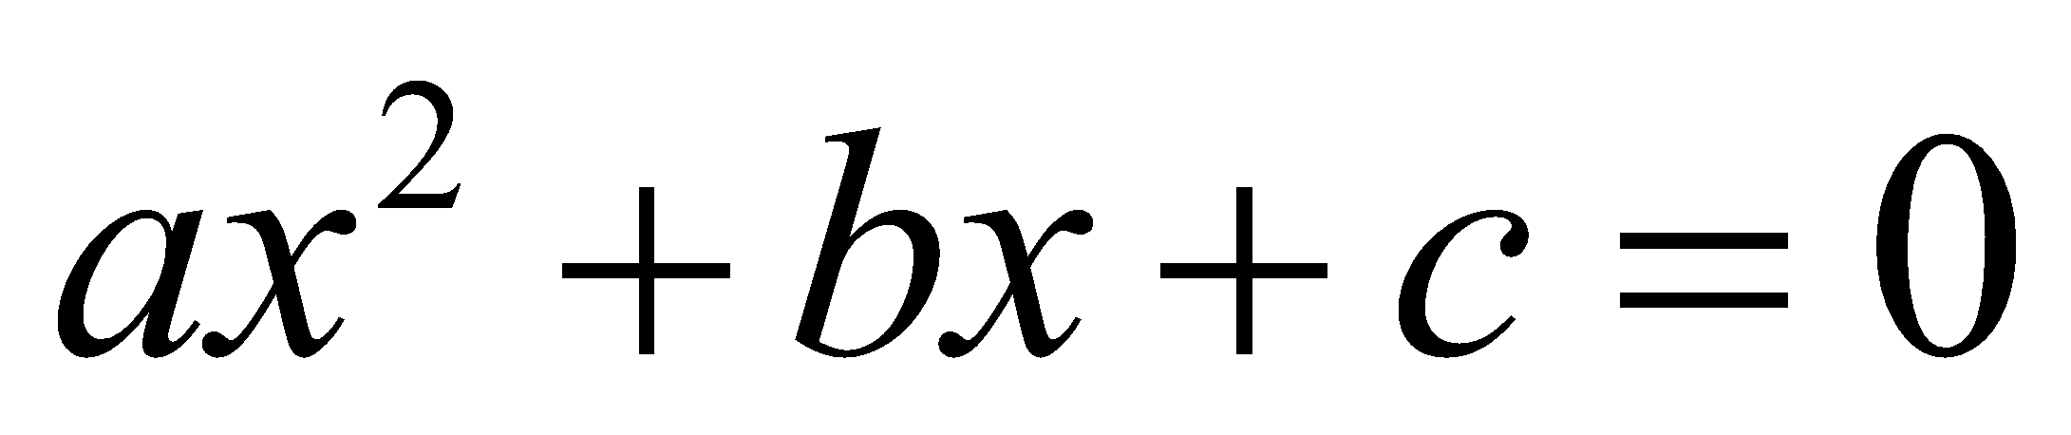
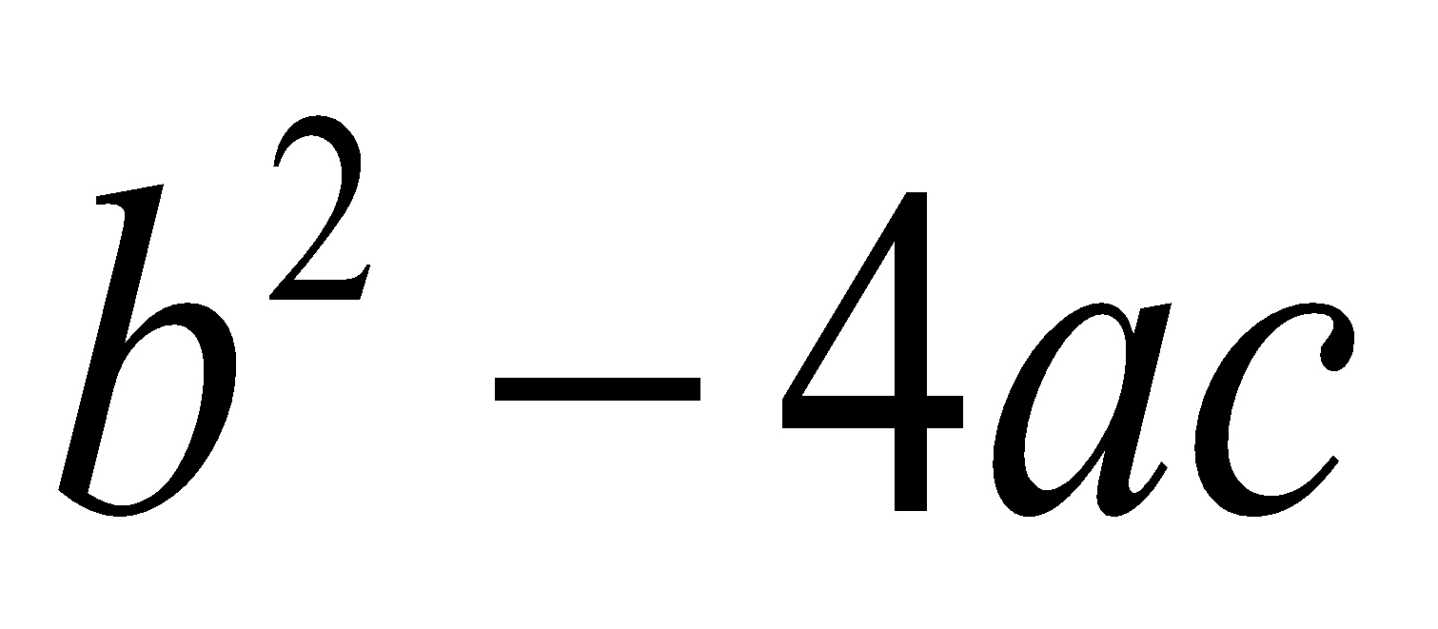
Example 9
Write an algorithm and draw a flowchart that will calculate the roots of a quadratic equation
Hint: d = sqrt ( ),
and the roots are:
If d<0 no solution
else
x1 = (–b + d)/2a and x2 = (–b – d)/2a
‹#›

Slide 24
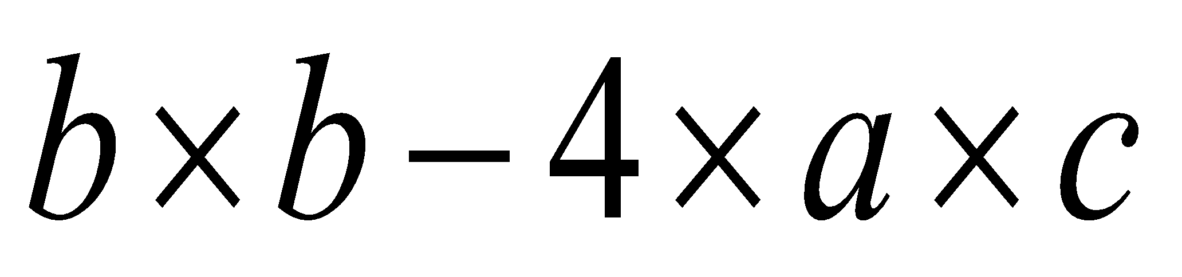
Example 9
START
Input
a, b, c
Algorithm:
Step 1: Input a, b, c
Step 2: d 🡸sqrt ( )
Step 3: x1 🡸 (–b + d) / (2 x a)
Step 4: x2 🡸 (–b – d) / (2 x a)
Step 5: Print x1, x2
d 🡸sqrt(b x b – 4 x a x c)
x₁ 🡸 (–b + d) / (2 x a)
X₂ 🡸 (–b – d) / (2 x a)
Print
x₁ ,x₂
STOP
‹#›

Slide 25
Example 10
Write an algorithm that reads two values, determines the largest value and prints the largest value with an identifying message.
‹#›

Slide 26
Example 10
START
ALGORITHM
Step 1: Input VALUE1, VALUE2
Step 2: if (VALUE1 > VALUE2) then
MAX 🡸VALUE1
else
MAX 🡸VALUE2
endif
Step 3: Print “The largest value is”, MAX
Input
VALUE1,VALUE2
Y
is
VALUE1>VALUE2
N
MAX 🡸VALUE1
MAX 🡸VALUE2
Print
“The largest value is”, MAX
STOP
‹#›

Slide 27
Example 11
Write and algorithm and draw a flowchart to
read an employee name (NAME), overtime hours worked (OVERTIME), hours absent (ABSENT) and
determine the bonus payment (PAYMENT).
‹#›

Slide 28
Example 11
Bonus Schedule
OVERTIME – (2/3)*ABSENT | Bonus Paid
>40 hours >30 but ≤ 40 hours >20 but ≤ 30 hours >10 but ≤ 20 hours ≤ 10 hours | $50 $40 $30 $20 $10
‹#›

Slide 29
Step 1: Input NAME,OVERTIME,ABSENT
Step 2: if (OVERTIME–(2/3)*ABSENT > 40) then
PAYMENT 🡸50
else if (OVERTIME–(2/3)*ABSENT > 30) then
PAYMENT 🡸40
else if (OVERTIME–(2/3)*ABSENT > 20) then
PAYMENT 🡸30
else if (OVERTIME–(2/3)*ABSENT > 10) then
PAYMENT 🡸20
else
PAYMENT 🡸10
endif
Step 3: Print “Bonus for”, NAME “is $”, PAYMENT
‹#›

Slide 30
Example 11
Flowchart: Draw the flowchart of the above algorithm?
‹#›

Slide 31
Example 12
Express an algorithm to get two numbers from the user (dividend and divisor), testing to make sure that the divisor number is not zero, and displaying their quotient using a flowchart.
‹#›

Slide 32
Example 12 Answer
Step 1 – Declare variables – dividend, divisor, quotient
Step 2 – Prompt user to get dividend
Step 3 – Store values in dividend variable
Step 4 – Prompt user to get divisor
Step 5 – Store value in divisor variable
Step 6 – Display dividend and divisor
Step 7 - Loop
Selection: If divisor is equal to zero
Display error message, “divisor must be non-zero” and
go back to step 4
Step 8 - Calculate quotient as dividend/divisor
Step 9 - Display quotient
‹#›

Slide 33



